Slide 1
Project Management:
Process, Technology, and Practice
Ganesh Vaidyanathan
Chapter 3
Project Management Tools

Slide 2
Tools

Slide 3
Learning objectives
Describe various tools that are available for project managers
Explain how to brainstorm with your project team and come up with decisions
Explain how to use a Thought Process Map with a project team to represent the entire team’s thoughts, ideas, and questions relative to accomplishing the project goal
Explain how to use Quality Functional Deployment and understand customer requirements for scope development
Understand how to satisfy customers using the Kano Model

Slide 4
Learning objectives
Discuss how to find the cause and the effects of problems using fishbone diagrams
Explain how to use the Delphi technique in projects
Implement SWOT analysis and burndown charts
Understand various collaboration tools and project management software

Slide 5
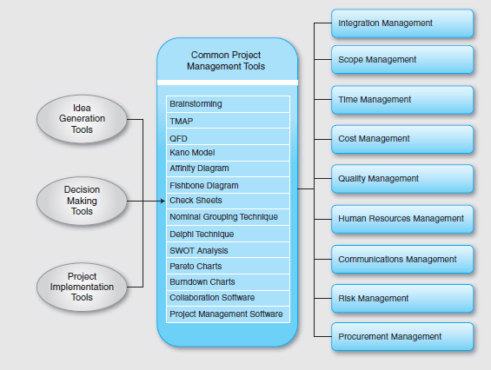

Slide 6
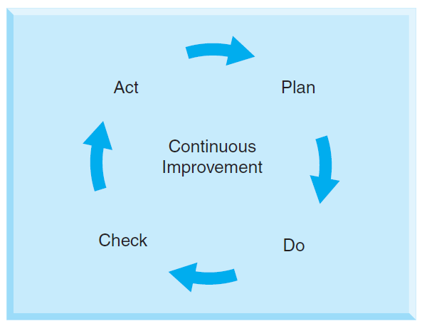
PM Tools
Project process improvements contribute to the success of projects.

Slide 7
Tools
Brainstorming
Thought Process Map (TMAP)
Quality Functional Deployment (QFD)
Kano model
Delphi Technique
SWOT analysis
Communication and Collaboration Tools

Slide 8
Brainstorming
Teams often meet to generate ideas on any topic.
Brainstorming
Establishes an efficient process that is free of criticism and judgment.
Encourages open thinking among team members and involves all team members in the process.
Works well if team members build on each other’s creativity focusing on a single topic.
Collects team knowledge.
As a structured process
Team members provide ideas in turn.

Slide 9
Brainstorming
As an unstructured process
Team members provide ideas at random.
Individual team members paraphrase their ideas, clarify, and record them on a flipchart or board.

Slide 10
Brainstorming
Ring-Exchange Technique, originally named Method 635
Six members sit around a table.
Team members generate three ideas and put them at the top of three columns on a sheet.
On command, the sheets are passed to the neighbor who tries to further develop the ideas.
New ideas are built on previous ideas in the same column.
Sheets are passed around five times and the time allotted for each round is limited to approximately five minutes.

Slide 11
TMAP
A graphical representation of a series of ideas or thoughts or decisions of a person or a team
An initial process for accomplishment of the project goals
A visual representation of an entire team's thoughts, ideas and questions relative to accomplishing the project goal
Should be one of the first tools employed when starting any project
Presents a structure of information and helps a team progress through the project process
A living document that will change throughout the project and has no set format

Slide 12
TMAP
A TMAP can be used to drive specific actions and select tools that are needed to complement those actions.
It also allows the team members to refer back to how, why, and when decisions were made.

Slide 13
TMAP
Define the project goal(s)
List the knowns, unknowns, and constraints
Ask DMAIC questions and "grouped" questions
Sequence and link all team comments, responses, and questions
Improve and link all responses to form a thought map
Identify possible tools to be used

Slide 14
TMAP
Define the project goal(s)
Problem Statement:
"Financial reports are late every month"

Slide 15
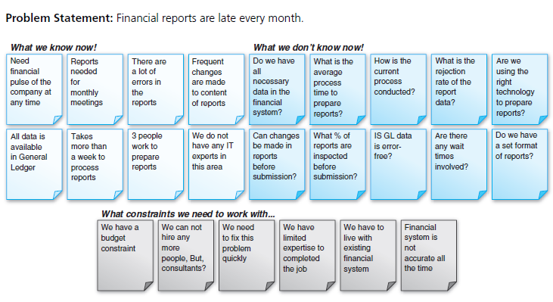
TMAP
List the knowns, unknowns, and Constraints

Slide 16
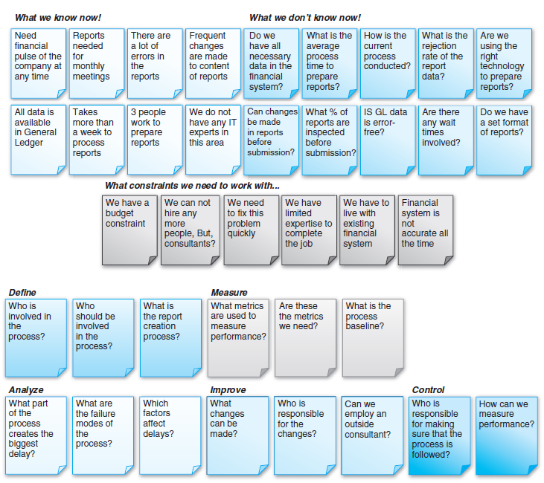
TMAP
Ask DMAIC questions and "grouped" questions

Slide 17
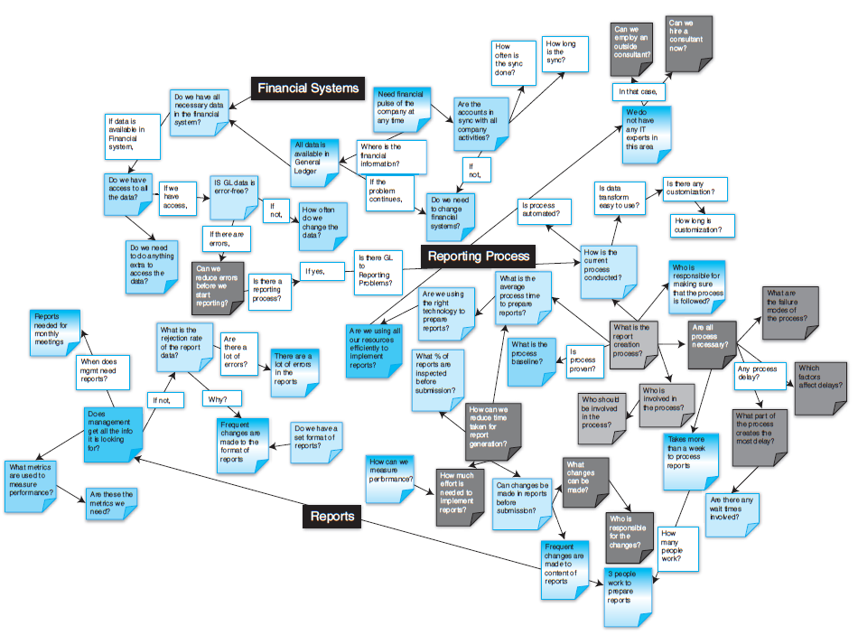
TMAP
Sequence and link all team comments, responses, and questions
Improve and link all responses to form a thought map

Slide 18
TMAP
Identify possible tools to be used
Questions |  | Responsible Person | Completion Date
What metrics are used to measure performance? | Gather data on how late reports get ready | XXX | MM/DD/YYYY
Do we have all necessary data in the financial system? | Check all data in monthly financials | XXX | MM/DD/YYYY
Are the accounts in sync with all company activities? | Check General Ledger for errors | XXX | MM/DD/YYYY

Slide 19
Quality Functional Deployment QFD
House of quality
A fundamental foundation in understanding customer requirements; links customer requirements to project planning, analysis, design, and implementation
Consists of six major components:
Customer requirements
Technical requirements
Planning matrix
Inter relationships
Technical correlations
Technical priorities, benchmarks, and targets

Slide 20
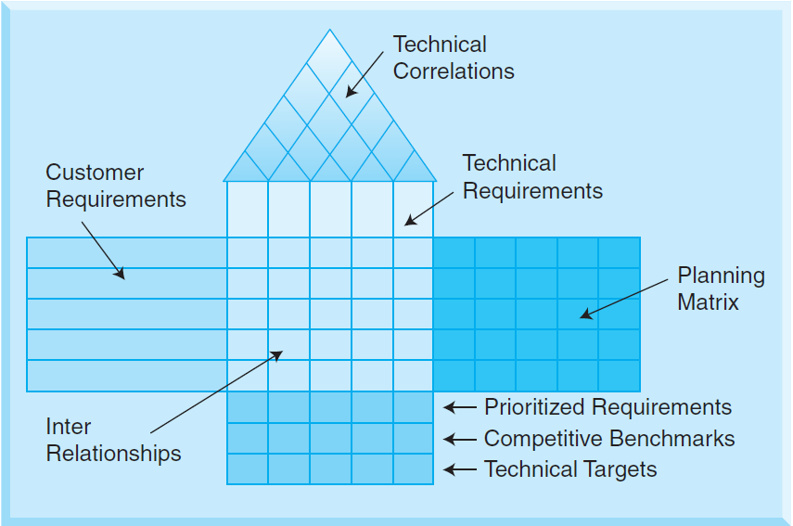
QFD

Slide 21
QFD
Determine, clarify, and specify customer needs in customer requirements component
Identify what customers want and how to satisfy these wants in technical requirements component
Complete planning matrix
Establish a connection between customer requirements and performance measures in interrelationships component
Complete technical correlations on the roof of the house of quality
Complete technical properties, set design targets and benchmarks

Slide 22
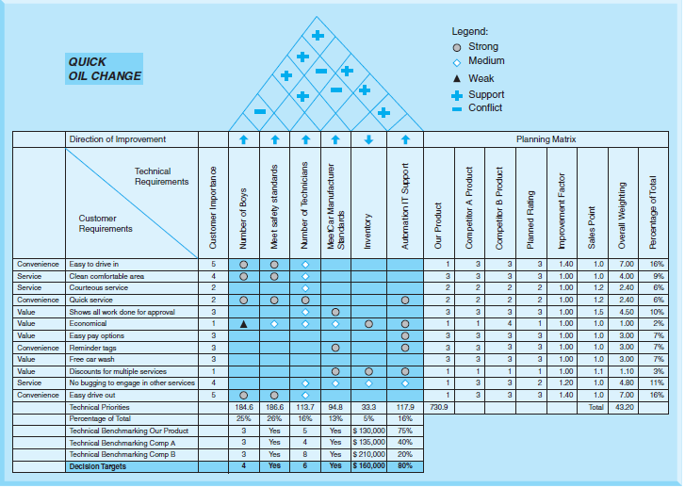
QFD

Slide 23
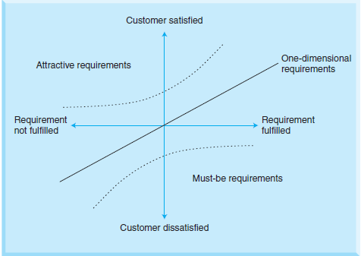
Kano Model
Distinguishes between three types of product requirements which influence customer satisfaction:
must-be requirements
one-dimensional requirements
attractive requirements
Leather/colors Seats
Heated Seats
Automobile Seats

Slide 24
Kano Model
Must-be requirements: The customer will be extremely dissatisfied if these requirements are not fulfilled. Fulfillment of these requirements will not increase customer satisfaction as customers can take these requirements for granted.
Example: Brakes in an automobile.
One-dimensional requirements: Customer satisfaction is proportional to the level of fulfillment — the higher the level of fulfillment, the higher the customer satisfaction and vice versa. These requirements are usually explicitly demanded by the customer.
Example : Better fuel economy in an automobile.

Slide 25
Kano Model
Attractive requirements: These requirements have the greatest influence on customer satisfaction. They are neither explicitly expressed nor expected by a customer. If fulfilled, customers are very satisfied. There is no feeling of dissatisfaction if they are not met. These are of exciting quality to customers.
Example: Selection of attractive seat colors, real leather seats, bigger trunk space, power, and more storage space
Indifferent requirements: These requirements result in neither satisfaction nor dissatisfaction regardless of whether they are fulfilled or not. Customers just do not care.
Example: Various mechanical mechanisms to adjust the rear seat.

Slide 26
Kano Model
Reverse requirements: These requirements result in dissatisfaction when fulfilled and satisfaction when not fulfilled.
Example: Sinking feeling in some car seats.
In projects, Kano model can be employed to identify customer needs and functional requirements as well as during concept development.

Slide 27
Delphi Technique
This is a widely used tool to achieve aggregate opinions concerning real-world knowledge solicited from experts within certain topic areas.
Procedure:
Round 1: An open-ended questionnaire soliciting information about a specific content or problem or issue is designed. The questionnaire is sent to all those who have been identified as respondents, the DT participants. After receiving the responses, the collected information is used to design a well-structured questionnaire. This questionnaire is used as the survey instrument for the second round of data collection.

Slide 28
Delphi Technique
Round 2:
Based on the responses from the first round questionnaire, a summary of all results is collated by the project manager and a second questionnaire is designed. Each DT participant receives the second questionnaire and is asked to review and respond. The DT participants are also asked to rate or rank items to establish preliminary priorities among them. They are also asked to state the rationale concerning rating priorities among items. Using the results of round 2, areas of disagreement and agreement are identified. Usually in this round, consensus begins to form and the actual outcomes can be discovered among the responses.

Slide 29
Delphi Technique
Round 3: The results from second round are sent to the DT participants in the third round. Each DT participant receives a questionnaire that includes the items and ratings summarized by the investigators in the previous round. The DT participants are asked to revise their judgments or to specify the reasons for remaining outside the consensus. The third round provides an opportunity for the DT participants to make further clarifications in their responses. Prior research has concluded that a slight increase in the degree of consensus can be expected at the end of this round as the participants have the last chance to revise their judgments.

Slide 30
Delphi Technique
Round 4: The list of remaining items, their ratings, minority opinions, and items achieving consensus are distributed to the DT participants. This round provides a final opportunity for all participants to revise their judgments and provide any other feedback on the problem or issue at hand.

Slide 31
SWOT
A strategic method for identifying whether to use a component or a feature in a project
Commonly used tool for identifying gaps and potential for improvements in projects
Internal strengths and weaknesses of a project
External environmental opportunities and threats facing that project

Slide 32
SWOT
Procedure:
Establish objectives: The objectives of the project issue need to be clearly expressed. The purpose of conducting a SWOT analysis must be discussed at first with the team and a consensus to a clear topic must be attained. The scope of the topic may be wide, narrow, general, or specific. The project manager needs to establish that the final outcome of the SWOT analysis would emerge from contribution and discussion and not from personal views, no matter how much expertise the participants possess individually.

Slide 33
SWOT
Procedure:
Delegate research and information-gathering task: The project manager has to ask each participant in the SWOT analysis team to prepare all background information. This preparation is an important part of an effective SWOT analysis. The background preparation is gathering information on strengths and weaknesses of the project issue and should focus on the internal factors of skills, resources, assets, or lack of them. Opportunities and threats should focus on external factors over which the participants have little or no control, for example, social or economic factors.

Slide 34
SWOT
SWOT analysis: The project manager should call for a SWOT analysis meeting to discuss the findings of all participants.
Procedure:
List SWOT factors: List all the internal strengths and weaknesses of the project and the environmental opportunities and threats facing the project.
Evaluate SWOT factors against established objectives: Sort and group the listed SWOT factors in relation to the already established objectives. Use those SWOT factors to come up with new strategies, priorities, schedules, project selection, project organizational structure, and outsourcing of projects.

Slide 35
Collaboration Tools
Lotus Domino http://www.youtube.com/watch?v=kmgRnk5VSO0
Office Groove
http://office.microsoft.com/assistance/asstvid.aspx?assetid=XT100627131033&vwidth=700&vheight=530&type=flash
MS Project
http://www.microsoft.com/project/en-us/demos.aspx

Slide 36
Project Tools
Table 3.3 Tool Selection
 | Generating ideas | Making Decisions | Project Implementation
Brainstorming
TMAP
QFD
Kano Model
Affinity diagram
Fishbone diagram
Check sheets
Nominal Grouping Technique
Delphi technique
Pareto Charts
SWOT analysis
Burndown charts
Collaboration Software
Project Management Software

Slide 37
Summary
Brainstorming collects team knowledge and encourages open thinking among team members. This tool is used extensively in project management to involve all members and obtain input from all team members.
A Thought Process Map is a graphical representation of a series of ideas or thoughts or decisions of a person or a team to accomplish a project goal. It is the first tool to be employed when starting any project. This collaborative team effort is used to encapsulate all factors affecting a project. It is typically represented by information in a structured visual format that can be referred to throughout the project by the project team.

Slide 38
